Slide 1


Slide 2
Transformational Leadership & Charisma
Definition
Charisma - A special personality characteristic that gives a person superhuman or exceptional powers and is reserved for a few, is of divine origin, and results in the person being treated as a leader (Weber, 1947)
Charismatic Leadership Theory (House, 1976)
  Charismatic leaders act in unique ways that have specific charismatic effects on their followers
Notes:
At the same time House published theory of charismatic ldrship. Got lot of attention. Described in same way as tsfl if not synonym.
Charisma is a fire, a fire that ignites followers’ energy and commitment, producing results above and beyond the call of duty. Charisma is the product of three elements: (1) a spark-a leader who has charismatic qualities, (2) flammable material-followers who are open or susceptible to charisma, and (3) oxygen-an environment conducive to charisma. Charisma is not the spark. It is not the flammable material. And it is not the oxygen. Charisma is the product of their union. Charisma resides in the relationship between a leader who has charismatic qualities and those of his or her followers who are open to charisma, within a charisma-conducive environment.

Slide 3
Theory of Charismatic Leadership
(Shamir, House, & Arthur, 1993)
Later Studies
Charismatic Leadership –
  Transforms follower’s self-concepts; tries to link identity of followers to collective identity of the organization
    Forge this link by emphasizing intrinsic rewards & de-emphasizing extrinsic rewards
    Throughout process leaders
      Express high expectations for followers
      help followers gain sense of self-confidence and self-efficacy

Slide 4
Model of Transformational Leadership
Bass (1985)
Transformational Leadership Model
  Expanded and refined version of work done by Burns and House. It included:
    More attention to follower’s rather than leaders’ needs
    Suggested TL could apply to outcomes that were not positive
    Described transactional and transformational leadership as a continuum
  Extended House’s work by:
      Giving more attention to emotional elements & origins of charisma
      Suggested charisma is a necessary but not sufficient condition for TL

Slide 5

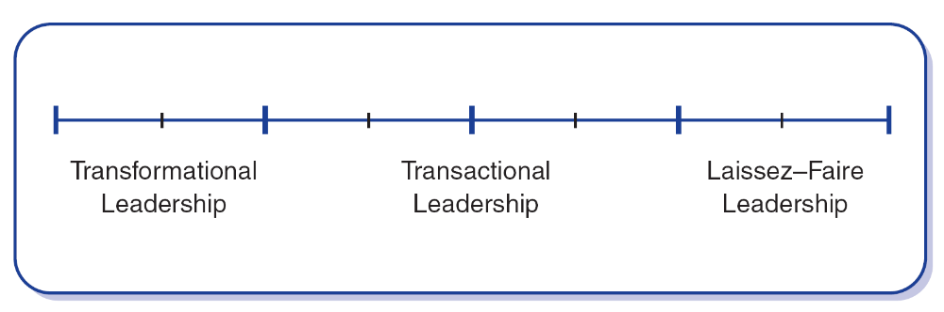
Model of Transformational Leadership
Bass (1985)
TL motivates followers beyond the expected by:
raising consciousness about the value and importance of specific and idealized goals
transcending self-interest for the good of the team or organization
addressing higher-level needs

Slide 6
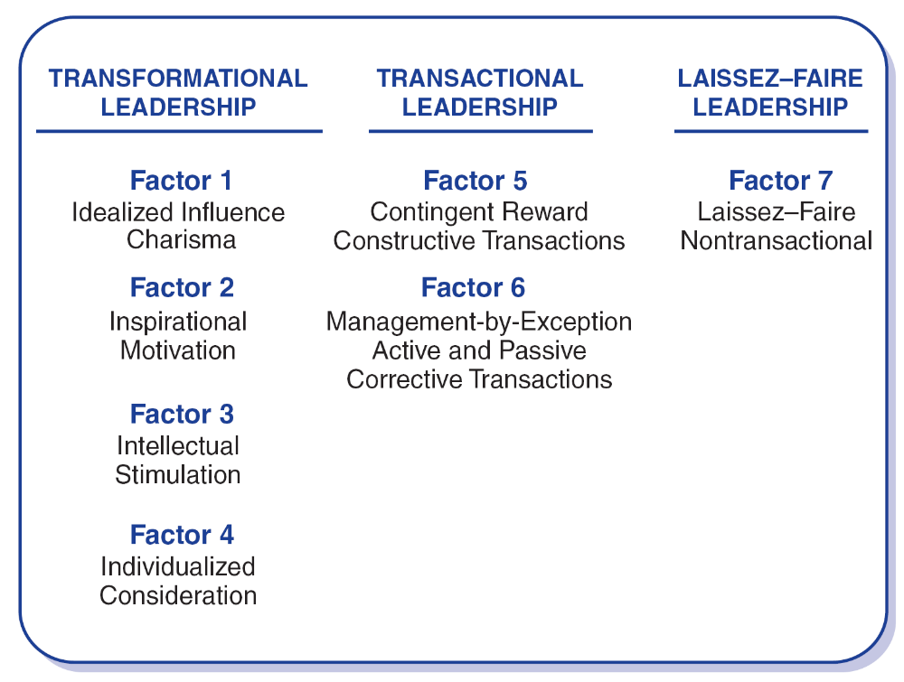
Transformational Leadership Factors
Leaders who exhibit TL:
have a strong set of internal values & ideals
are effective in motivating followers to support greater good over self-interest

Slide 7
Transformational Leadership Factors
The 4 “I”s
Idealized Influence
Charisma
Describes leaders who act as strong role models for followers
  followers identify with leaders and emulate them
Leader’s have high standards of ethical and moral conduct
    followers deeply respect & trust L’s
    L’s provide a vision and sense of mission

Slide 8
Transformational Leadership Factors
The 4 “I”s
Inspirational Motivation
Leaders who communicate high expectations to followers
  inspiring followers through motivation to commitment and engagement in shared vision of the organization
  L’s use symbols & emotional appeals to focus group members to achieve more than self-interest; team spirit promoted

Slide 9
Transformational Leadership Factors
The 4 “I”s
Intellectual Stimulation
Stimulates followers to be creative and innovative
Challenge their own beliefs and values those of leader and organization
Leader supports followers to
  try new approaches
  develop innovative ways of dealing with organization issues

Slide 10
Transformational Leadership Factors
The 4 “I”s
Individualized Consideration
Leaders who provide a supportive climate in which they listen carefully to the needs of followers
Leader’s act as coaches and advisors encouraging self-actualization

Slide 11
Transactional Leadership Factors
Transactional Leaders –
Leaders do not individualize the needs of subordinates nor focus on their personal development
Exchange things of value with subordinates to further both’s agendas

Slide 12
Transactional Leadership Factors
Contingent Reward
The exchange process between leaders and followers in which effort by followers is exchanged for specified rewards
Management by Exception
Leadership that involves corrective criticism, negative feedback, and negative reinforcement
  Two forms
    Active - Watches follower closely to identify mistakes/rule violations
    Passive - Intervenes only after standards have not been met or problems have arisen

Slide 13
Nonleadership Factor
Laissez-Faire
The absence of leadership
A hands-off, let-things-ride approach
Refers to a leader who
  abdicates responsibility
  delays decisions
  gives no feedback, and
  makes little effort to help followers satisfy their
  needs

Slide 14
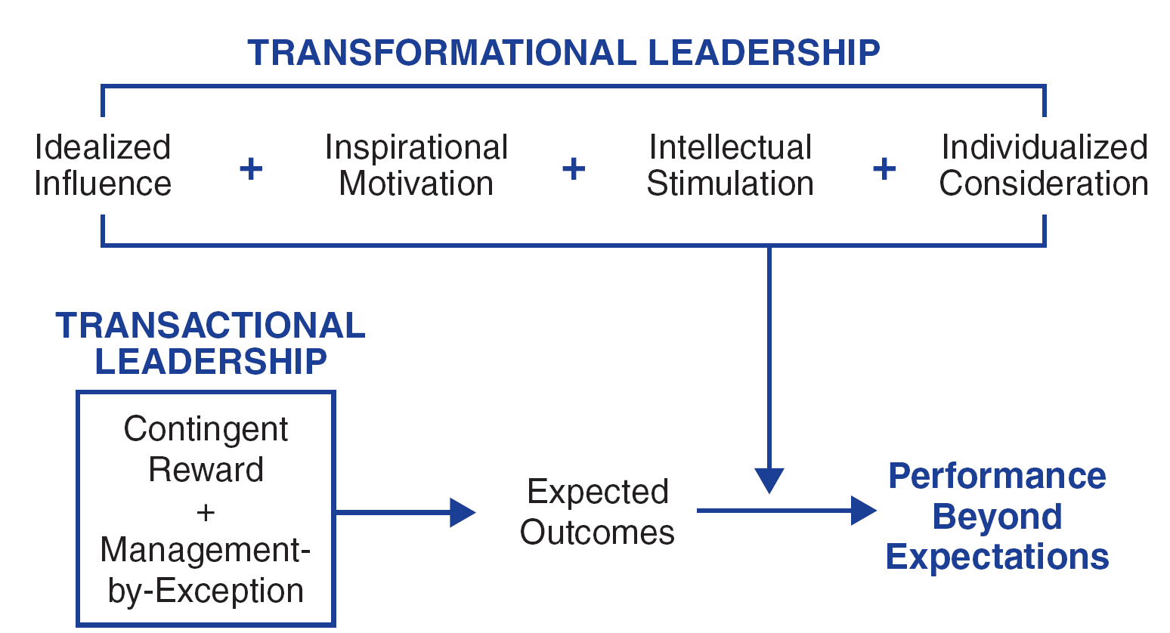
Additive Effect of
Transformational Leadership

Slide 15


8/2/2012

Slide 16


پاکستان زندہ باد

